Slide 1
The New Planning Service in Somerset
Parish Briefing
Stuart Houlet and Dawn de Vries

Slide 2
Development Management for Somerset Council
New Planning Service Structure
Planning Committee Structure and Processes
Scheme of Delegation
Consultations
Commenting on Applications
Public Speaking Arrangements
Website

Slide 3
Introduction and Background
Constitution was approved at Full Council on 22 February 2023 – available on Somerset Council website- Constitution, pages 163-183, Somerset County Council
Membership of Planning Committees approved at Full Council on 1 March 2023 – available on Somerset Council website
Training to be provided to all 110 Councillors on Planning and we will also be briefing all Planning Officers on the matters discussed here
Planning Guidance for Parish Councils will be circulated as soon as possible with the intention to provide additional training
Draft Statement of Community Involvement - https://somerset.inconsult.uk/sci/consultationHome

Slide 4
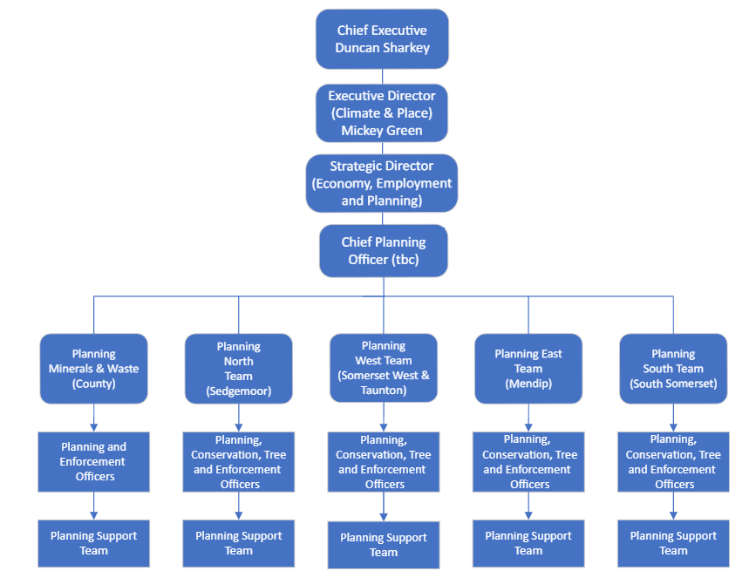
Structure of the Council/Planning Teams
The Chief Planning Officer is also responsible for Planning Policy and Implementation
Former District Office addresses will remain the same
Officers will continue to work hybrid but their office base will also remain the same

Slide 5
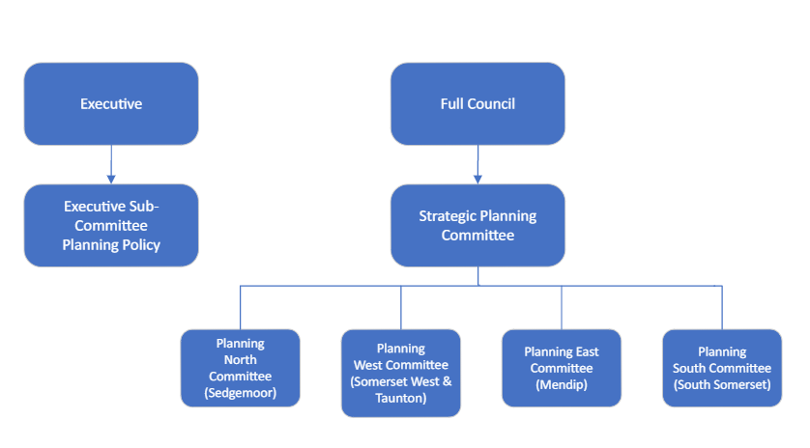
Committee Structure
Policy
Development Management

Slide 6
Scheme of Delegation
Waste and mineral applications (other than departures from the Development Plan) - will be considered at the area based Planning committees first
Only if the recommendation is overturned will they be considered at Strategic Committee
All other applications that require a committee decision will be dealt with at the area based Planning Committees
The scheme of delegation is a mixture of:
  Automatic referral to planning committee (Major applications)
  Referral following comments from a Divisional Member and/or a Parish/Town/City Council that are contrary to the recommendation via Referral to Chair/Vice Chair of the relevant Planning Committee
  Officer delegation

Slide 7
Applications Delegated to Officers
The following matters are delegated to Officers and exempt from the referral process:
  Certificates of Lawfulness Existing or Proposed
  Prior Approval/Prior Notification – all types
  Approval of details reserved by condition
  Hazardous substance consents
  Any applications for works to trees, hedgerow removal or high hedges
  Permission in Principle (PIP)

Slide 8
Consultations
The Parish Council will be consulted on the following applications – your comments on these applications will potentially trigger a referral to Planning Committee:
  Planning permission (outline and full)
  Advertisement consent
  Listed building consent
  Application for planning permission for relevant demolition in a conservation area
  Reserved matters approval following outline permission
  Variation/removal of conditions (S.73 Applications)
Parish Councils will also be notified of applications for Permission in Principle, prior approvals, certificates of lawfulness and applications for works to trees - BUT the decisions would be delegated to Officers meaning they would not be referred to Planning Committee

Slide 9
Commenting on an Application
The application details, including all plans and reports, will be available to view on the Council’s website – a link will be provided in the notification letter
The notification letter will explain how to submit comments – if you email comments then the email address will change, other than that the process will be the same
Parish Councils need to either:
  Support or Object; and provide material planning reasons; or
  Confirm comments only but this would not trigger the referral process
Parish Councils need to respond by the target date set out in consultation letter – usually 21 days or 14 days
You can request an extension to the target date, which will be agreed where possible. Please get in touch with the Case Officer as soon as possible to agree this
Consultation letters will include Case Officer’s name, email address and direct line number
Notes:
We are trying to keep the process as it is now for the area that you are currently in. The main difference is that you will be directed in the first instance to the new Somerset Unitary webpage. From there you will be able to access all the different commenting platforms and a link to these will be provided in your consultation and notification letters. If you comment via e mail the process will remain the same but the e mail address will have changed. As commenting will still differ between the Parish/Town/City Councils there will guidance on the letters setting out the right link and outlining the process which will still be as you are currently used to doing. For some of you this will be a form that needs to be e mailed in whilst for others you will be directed to the website. The important thing is that the process of commenting is not going to change between end of March and start of April but the website you land on will look different.
As set out previously please be clear if you support, object or are just commenting and please make sure you set out your material planning reasons for doing so. This is so we can understand your concerns and where possible seek to address them with the applicant or developer. If you are only providing a comment this will be neutral and will not result in the referral process.
As existing, there will be limits to the timing of consultation. Please respond within the timeframes given or if this is not possible please contact the officer to agree an extension of time for your comments. New edition for some, we will be providing the direct contact details of the case officer (direct telephone number and e mail address) so you can contact them more readily. I would also recommend coping in the general planning area e mail address into correspondence to ensure it is scanned onto the file.
Extending consultation will not be possible for notifications and notifications are not subject to the deferral process.
From vesting day all officers and area teams will have new e mail addresses although there will be a limited time when the old ones still work.

Slide 10
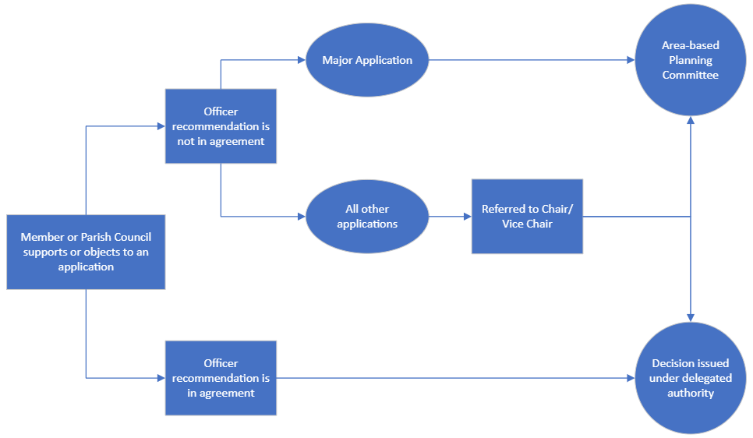
This applies for the original notification and also any notification resulting from the submission of revised plans.

Slide 11
When an application is referred to Committee:
Parish/Town/City Councils, Divisional Members, Contributors (objectors/supporters) and the Agent/Applicant will receive a notification email confirming:
    The application details
    The date, time and location of the meeting
    Instructions on how you can register to speak or to attend
To register to speak you will need to notify Democratic Services by 12 noon the working day before the Committee
Hybrid Committees– you can attend and/or speak on an application in person or virtually
A link to a Planning Committee Guidance Note

Slide 12
Public Speaking At Planning Committee:
Order of Speaking:
Members of the public, or their representatives, objecting to or in support of the application;
Town or Parish Councils;
Members of the Council (non-Planning Committee members);
The applicant or agent
Members of the public in Opposition (3 mins each, up to 5 speakers) | Members of the public in Support (3 mins each, up to 5 speakers) | Parish /Town/City Council | Applicant / Agent | Member(s) (non Planning Committee Members)
15 mins shared | 15 mins shared | 3 mins each | 3 mins shared | 3 mins each

Slide 13
New Website for Somerset
A new website for Somerset will be live from 1 April 2023
The existing District and County Council websites will no longer be accessible although the functionality of the planning online pages will be the same, we will provide a link to the new pages w/c 3rd April
Any links will be refreshed to allow re-direction to the new Somerset website
Once the new website is live, we will be updating web links in our existing documents
You will still be able to ‘track’ an application online. This means you can be automatically notified of new applications or changes to their status. Details can be found on their respective websites.

Slide 14
Thank you
If you have any questions you would like covered in the next session please e mail:
Development.management@sedgemoor.gov.uk before 1st April or PlanningNorth@somerset.gov.uk after 1st April.

